Slide 1
Enhance Safety (Au)
Module 9

Slide 2
Module 9: Learning Objectives
At the end of this session students should be able to demonstrate knowledge of:
How to assess the level of danger a woman and her children are in
How to make a safety plan
How to respond to perpetrators of violence
Notes:
At the end of this session students should be able to demonstrate knowledge of:
How to assess the level of danger a woman and her children are in
How to make a safety plan
How to respond to perpetrators of violence

Slide 3
Review Hahu Relasaun di’ak
Notes:
Ask the students ‘can anyone tell me the steps in Hahu Relasaun?’ Compliment the student who recalls it.
These are the elements of good practice when responding to victims of violence
Point out that in the last module we learned about confidentiality and this is the most important element for the safety of the patient

Slide 4
Enhancing Safety
Understand and believe her
Help her assess the situation
Many women have fears about their safety
Others may not think it will happen again
An ongoing process of support
Notes:
The purpose is to show her that you understand and believe her - Assure her that she is not to blame.
Help assess her situation and make a plan for her future safety.
Many women who have been subjected to violence have fears about their safety.
Other women may not think they need a safety plan because they do not expect that the violence will happen again. A health provider can explain that domestic violence is not likely to stop on its own, that it tends to continue and may become worse and happen more often
Assessing and planning for safety is an ongoing process – it is not just a one-time conversation.

Slide 5
Assessing danger
If she is afraid to go home – take her seriously
Some women may need help thinking about their safety
Specific questions to assess risk of serious injury
Notes:
Some women will know when they are in immediate danger and are afraid to go home. If a woman is worried about her safety, take her seriously. You can call the police or refer her to a safe house, or she could stay overnight at the hospital or with other family. We will be talking more about specific referral services next week.
Some women may need more help thinking about their safety.
There are specific questions you can ask to assess whether it is likely to be unsafe for her to return to her home - It is important to find out if there is an immediate risk of serious injury.

Slide 6
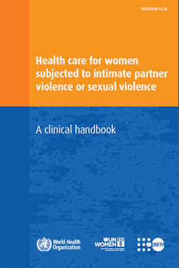
WHO Clinical Handbook
Danger Assessment tool
Notes:
These danger assessment and safety planning questions have been developed by the WHO and are based on many years of research with victims of violence from all over the world. They are also available in the WHO Clinical Handbook.

Slide 7
Questions for assessing danger
Women who answer ‘yes’ to at least 3 of the following questions may be in immediate danger from the perpetrator:
Has the physical violence happened more often or gotten worse over the past 6 months?
Has he ever used a weapon or threatened you with a weapon?
Has he ever tried to strangle you?
Do you believe he could kill you?
Has he ever beaten you when you were pregnant?
Is he violently and constantly jealous of you?
Is he violent toward your children?
Are the children present when he is violent toward you?
Notes:
Women who answer ‘yes’ to at least 3 of the following questions may be in immediate danger from the perpetrator:
Has the physical violence happened more often or gotten worse over the past 6 months?
Has he ever used a weapon or threatened you with a weapon?
Has he ever tried to strangle you?
Do you believe he could kill you?
Has he ever beaten you when you were pregnant?
Is he violently and constantly jealous of you?
Is he violent toward your children?
Are the children present when he is violent toward you?

Slide 8
Activity: Assessing danger
Break into groups
Read the case study about Natalia and Gerson
Discuss the following questions:
  Do you think Natalia’s life is in danger?
  What criteria did you use to decide whether her life is in danger or not?
  What risk factors can you identify in the case study?
Notes:
Purpose: understanding common risk factors and assessing the level danger a woman and her children likely to be in
Time: 15 minutes (10 minutes for discussion, 5 minutes for feedback)
Instructions:
Break into groups
Read the case study about Natalia and Gerson (which is in the handouts)
Discuss the following questions
Do you think Natalia’s life is in danger?
What criteria did you use to decide whether her life is in danger or not?
What risk factors can you identify in the case study?
Each group should come up with an agreed opinion on whether Natalia’s life is in danger and have statements that support their assessment to feed back to the larger group

Slide 9
If there is immediate danger
If there is immediate danger – let her know your concern
Provide information on options
Identify a safe place she can go
Help make a safety plan
Notes:
If she is in immediate danger you can say “I’m concerned about your safety. Let’s discuss what to do so you won’t be harmed”.
It may not be safe for her to return home
Provide information on options such as contacting the police or make arrangements to stay at a safe house
If that is not possible, work with her to identify a safe place she can go such as a friend’s home, her family, church, or stay overnight at the hospital
Help to make a safety plan

Slide 10
Safety plans
If there is not immediate danger – still do a safety plan
A safety plan can help women to:
  Recognize violence and its effects
  Clarify priorities for safety
  Identify how to get support
Notes:
Even women who are not facing immediate danger could benefit from having a safety plan. If she has a plan, she will be better able to deal with the situation if violence suddenly occurs.
A safety plan can help a woman or adolescent to…
Recognize violence and the impact on their health and well-being
Clarify priorities for safety (e.g. children, having resources, feelings for partner, stigma/privacy)
Identify how to get support for those priorities

Slide 11
Safety Plan
A safe place | If you need to leave home quickly, where will you go?
A plan for the children | Will you go alone, or will you take your children with you?
Transport | What transport will you use when you leave?
Things you will take | What would you need if you left? What is essential? Items to suggest: documents, keys, money, clothes, medicines for yourself and children, children’s favourite toy Do you have a safe place for those items?
Money | Can you access money if you need to? Can you access it in an emergency?
Support from people that are close | Is there anyone nearby you feel could be helpful? Can they come with assistance/call police if they hear sounds of violence? Can you leave important items with them?
Notes:
These are the questions you should ask, and answers you should discuss in order to help a woman make a safety plan.
Is there anything else you might ask in the Timor Leste context?
Point out that safety priorities change, discuss revisiting safety actions with a trusted person
RESPECT HER DECISIONS
In your study guide you will find a handout with the danger assessment and safety planning questions, as well as other suggestions for enhancing safety.

Slide 12
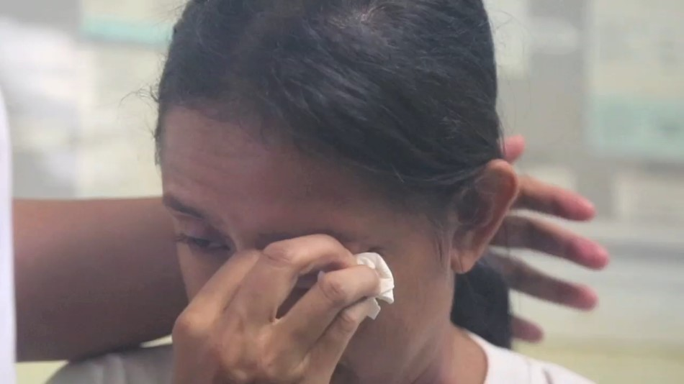
Watch video role play
Watch the video role play and think about the following questions:
  How did the nurse raise the topic of enhancing safety?
  How did the nurse convey respect for Maria’s decisions?
  How did the nurse help Maria to make a safety plan?
Notes:
While watching scene 4 of the video role play think about the following questions:
How did the nurse broach the topic of enhancing safety?
How did the nurse convey respect for Maria’s decisions?
How did the nurse help Maria to make a safety plan?
The video can be played directly from the weblink https://youtu.be/D5Pgnsw-xXs.
Play the section from time 7:33-12:22.

Slide 13
Activity: Video Role Play
Discussion questions
  How did the nurse introduce the topic of enhancing safety?
  How did the nurse convey respect for Maria’s decisions?
  How did the nurse help Maria to make a safety plan?
Notes:
Purpose: To observe a health provider talking about safety and respecting a patient’s decisions
Time: 15 minutes (5 minutes video, 10 minutes discussion)
Instructions:
Ask students to watch the video and pay attention to how the nurse first asks about safety, respects Maria’s decisions and helps her make a safety plan
After the video discuss the following questions amongst the group:
How did the nurse bring up the topic of enhancing safety?
Asks how often the violence happens, how long it has been happening, whether he is violent with the children, “I am concerned about your safety and how this is affecting your health”, asked whether she has thought about harming herself.
How did the nurse convey respect for Maria’s decisions?
When Maria did not want to report to the police because it would put her safety at risk the nurse asked “what would you like to do?”, when Maria wanted to go home the nurse asks “Ok but I would like to talk about your safety. Is that ok?”, asks “Ok, what do you want to do about reporting to the police?” and respects her need for time to make a plan with her family.
How did the nurse help Maria to make a safety plan?
Nurse asks whether she feels safe to go home, if she has a safe place she can go, what would happen with the children, transport, help from the neighbours or people she trusts, have a bag packed with essential items, gave the number for the police

Slide 14
Activity: Role play safety planning
Break into groups of two
One is Merita, one is the health provider
Help Merita identify the level of danger she is in and develop a safety plan
Discuss the following questions:
    As Merita, what questions did you find useful or not useful?
    How realistic did you think the safety plan was?
    As the health provider, what was most difficult about this exercise?
    As the health provider, how did you feel at the end of the discussion with Merita?
Notes:
Purpose: Practice assessing danger and making a safety plan
Time: 20 minutes (5 minutes to read the case study, 5 minutes each to practice safety planning, 5 minutes for feedback)
Instructions:
Break into groups of two, one will be the patient, Merita, and one will be the health provider
Read the case study and take turns being Merita and the health provider
As the health provider, use the handout on ‘danger assessment and safety planning’ to identify with Merita the level of danger she is in and assist her in developing a safety plan
Case study:
Merita has arrived at the health centre with her two young children. She has soft tissue injuries to her upper arms where she has been held down by her husband and she also has abrasions around her neck where he has tried to strangle her with the handles of her basket. She tells the health provider that she has been beaten by her husband.
Lead a discussion with the larger group:
As Merita, what questions did you find useful or not useful?
How realistic did you think the safety plan was?
As the health provider, what was most difficult about this exercise?
As the health provider, how did you feel at the end of the discussion with Merita?

Slide 15
Engaging with men who use violence
Do not counsel both the woman and man about domestic violence
Refer him to see a different health provider
This is to avoid accidently revealing information she has told you
Men often justify the violence or blame the woman, so she needs a separate health provider that is not influenced by him
Source: Hegarty et al. 2016
Notes:
It is not recommended for a health provider to counsel both the woman and the man about domestic violence or about their relationship
If the health provider is seeing both of them as a patient, the man should be referred to see a different health provider.
Many men who use violence are worried the woman will tell others about it. If the health provider is seeing both the man and the woman there is a danger they could accidently reveal information about her and he might retaliate against her.
Men can also be persuasive in denying or justifying their violence, while blaming the woman and minimising their responsibility for their own behaviour. It is important for a different health provider to hear the woman’s story, so they are not influenced by him.

Slide 16
Case example: confidentiality
Read the case example (in the facilitator guide and the student guide)
Never break confidentiality
Always discuss what you might do and ask permission from the woman
She knows best about her safety
Notes:
Read the case example in the slide below, which shows why confidentiality is so important and why you should never speak to the perpetrator or the woman’s family about the information she gives you.
Doctor Ana was working in a sub-district CHC. She provided care to a married couple, Maria and Antonio, by themselves and together some times. She thought they were both sad because they were from a different district and had no family to help them. She thought she had a good relationship with the couple and they talked about their children. Maria had made a lovely woven cloth when Dr Ana had a new baby. One day, Maria came to see her by herself and she had some bruising. When Dr Ana asked about it, Maria disclosed she had been experiencing serious abuse from her husband Antonio for quite a long time. Dr Ana offered her some counselling but did not say anything about what she might say to Antonio. When Antonio came to the clinic to get his tablets, Dr Ana asked him few questions about his anger. Antonio guessed immediately that Maria must have told the doctor. He stood up, said ‘she has told you, hasn’t she!’ and he said ‘you won’t see us again!’ Dr Ana was very upset and tried several times to call Maria to tell her what had happened and to warn her. But when the phone was answered, it was Antonio and he slammed the phone down. Dr Ana remained very upset, as she realised that she had not discussed with Maria what she was going to say to Antonio. She knew Maria had no idea that she would try to talk to Antonio – and break her confidentiality – and put her in danger of a further beating. She never did see the couple again, Maria lost her access to a caring doctor and shortly afterwards they moved away.
Remind students
Never break confidentiality
Always discuss what you might do and ask permission from the woman
She knows best about her safety.

Slide 17
Case example: confidentiality
Doctor Ana was working in a sub-district CHC. She provided care to a married couple, Maria and Antonio, by themselves and together some times. She thought they were both sad because they were from a different district and had no family to help them. She thought she had a good relationship with the couple and they talked about their children. Maria had made a lovely woven cloth when Dr Ana had a new baby. One day, Maria came to see her by herself and she had some bruising. When Dr Ana asked about it, Maria disclosed she had been experiencing serious abuse from her husband Antonio for quite a long time. Dr Ana offered her some counselling but did not say anything about what she might say to Antonio. When Antonio came to the clinic to get his tablets, Dr Ana asked him few questions about his anger. Antonio guessed immediately that Maria must have told the doctor. He stood up, said ‘she has told you, hasn’t she!’ and he said ‘you won’t see us again!’ Dr Ana was very upset and tried several times to call Maria to tell her what had happened and to warn her. But when the phone was answered, it was Antonio and he slammed the phone down. Dr Ana remained very upset, as she realised that she had not discussed with Maria what she was going to say to Antonio. She knew Maria had no idea that she would try to talk to Antonio – and break her confidentiality – and put her in danger of a further beating. She never did see the couple again, Maria lost her access to a caring doctor and shortly afterwards they moved away.

Slide 18
Providing health care to men who use violence
Health assessment and take a history
Convey that abuse and violence are not okay
Enhance safety of women and children
Encourage him to take responsibility
Refer to behaviour change program if available
Report known incidences of abuse to the police
Source: Hegarty et al. 2016
Notes:
If you identify a man who uses violence you should do the following in addition to normal medical care
Do a health assessment and take a history – especially for suicidality, substance abuse, mental health, any adverse childhood experiences and weapon ownership
Convey that abuse and violence are not okay – condemn the actions, not the person
Enhance safety of women and children - Immediate safety of the partner and any children should be the main concern for a health provider when a man who uses domestic violence is identified.
Encourage a change in attitudes – help the man take responsibility for his behaviour and encourage active uptake of referrals.
Referral to a men’s behaviour change program is the best option. Some of these programs are currently being developed in Timor so ask around about what is available in your area. If he has mental health or drug/alcohol problems, check what referral services are available.
Report known incidences of abuse to the police – especially if severe violence, sexual assault or child abuse is involved then you have a responsibility to report the case to the police.

Slide 19
Important messages
Danger assessment identifies immediate safety needs
Trust your client if she feels in danger and find help
Do a safety plan so women and children know how to get help
Remember to listen and show empathy when asking questions
Never counsel a couple together about domestic violence
Refer him to a different provider
Notes:
Doing a danger assessment can help in understanding a women’s immediate risk and safety needs.
Remember to trust your client if she feels she is in severe danger and help her to access a safe house
Doing a safety plan can help women recognize violence and it’s impact, clarify their priorites and how they can get help for those priorities
Being empathetic, listening and communicating well will help when asking questions in the danger assessment and safety plan
You should never counsel both a man and woman about domestic violence and never reveal her information without her permission.
Refer authors of violence to a different health provider who can convey that violence is not acceptable, encourage him to take responsibility and refer him to services that can help him change his behaviour
Remember – learning how to respond to domestic violence, sexual assault and child abuse can be difficult. If you are experiencing any distress you can come and talk to me after class or you can contact the services listed in the referral handout.

