Slide 1
Definitions
Prevalence
Vulnerable groups
Module 1

Slide 2
Course competencies
At the end of this subject students should be able to:
Demonstrate knowledge of domestic violence, sexual assault and child abuse as public health issues
Identify signs of abuse and know when and how to ask about violence in a sensitive way
Practise women-centred care and be able to communicate with empathy
Enhance a woman’s safety and provide referral and ongoing support
Practise self-care and collaboration with colleagues
Notes:
This course is taught over 16 modules. At the end of this subject students should be able to:
Demonstrate knowledge of domestic violence, sexual assault and child abuse as public health issues
Demonstrate the ability to identify signs of abuse and know when and how to ask about violence in a sensitive way
Practise women-centred care and be able to communicate with empathy
Demonstrate how to enhance a woman’s safety and provide referral and ongoing support
Practise self-care and collaboration with colleagues

Slide 3
Looking after each other
A difficult topic
Many of us may have experienced or witnessed violence
Be caring and respectful of each other
Support services are available to help www.hamahon.tl
Notes:
Learning about violence can be difficult
Many of us may have experienced or witnessed violence, or had it happen to someone close to us
We need to be caring and respectful of our fellow students
There are special support services for survivors of violence and help for people who have experienced trauma - See handout on referral services if you or someone you know needs help.
This information with up to date phone numbers is available on the website www.hamahon.tl so please check it regularly for changes.

Slide 4
Activity: Brainstorm ground rules
Suggest ground rules for participation in the class
What are some ways we can look after ourselves and each other?
Notes:
Purpose: to brainstorm ground rules which will create a safe space for learning together and ensure everyone is treated with respect in the class
Time: 5 minutes
Ask students to suggest some ground rules for participating in the class
Respect confidentiality – if people share their personal stories they cannot be shared with others
Do not interrupt when people are talking.
Be respectful of different opinions
Allow everyone a chance to participate
Be present – keep use of electronics such as cell phones or laptops only for emergencies.
Explain that these rules will govern the rest of the course and that the list can be added to as we move along.
Ask what are some ways we can look after ourselves and each other?
Some material may trigger trauma for people who have experienced violence or know survivors of violence
You can step out of the room if at any time you feel uncomfortable
Come and see the lecturer after class to discuss any questions or concerns, or just to talk
Talk to each other, or to someone you trust
Practise self-care – do something nice for yourself, go for a walk or do some exercise, we will be learning more about breathing exercises to help us relax
There are special support services for survivors of violence and help people who have experienced trauma – point to handout with referral services on it.

Slide 5
Module 1: Learning Objectives
At the end of this session students should be able to demonstrate an understanding of the:
Definitions of domestic violence, sexual assault and child abuse
Prevalence of different forms of violence against women globally and in Timor-Leste
The cycle of violence and who is more vulnerable to being abused
Notes:
At the end of this session students should be able to demonstrate an understanding of the:
Definitions of domestic violence, sexual assault and child abuse
Prevalence of different forms of violence against women globally and in Timor-Leste
The cycle of violence and who is more vulnerable to being abused

Slide 6
What is domestic violence?
Physical, sexual, psychological, economic violence by family members
When one person abuses their power or control over another family member
Notes:
Domestic violence involves threats, physical, sexual or emotional violence or abuse by family members or people who may live in the same house
It occurs when one person, commonly an adult male, abuses their power or control over another family member, usually women and/or children
Most victims of domestic violence are women and children, and most of the time it is men who commit the abuse
Women are most likely to experience violence from their current for former husband or boyfriend, this is known as intimate partner violence

Slide 7
What are the types of intimate partner violence against women?
Physical violence
There are many types of violence, and often they occur at the same time in a relationship
Sexual violence
Emotional/ psychological abuse
Economic/ Controlling behaviors
Notes:
See handout on types of intimate partner violence against women
Emotional/psychological abuse - Calling her names or telling her she is ugly or stupid, Threatening to hurt her or her children, threatening to destroy things she cares about, Criticizing her repeatedly, Humiliating or belittling her in public
Physical violence – hitting, kicking, strangling/choking, burning, slapping, beating, hurting with a weapon, pushing/shaking
Economic/Controlling behaviour - Leaving a woman without money to run the home, destroying important documents or household/money-making items, Insisting on knowing where she is at all times, Not allowing her to go out of the home (i.e. to work or see family), Not allowing her to seek health care, without permission, Often being suspicious that she is unfaithful
Sexual violence - Forcing someone to have sex or perform sexual acts they don’t want to, Harming her during sex, Forcing or coercing her to have sex without protection from pregnancy or infection.
These different types of violence often happen together in the same relationship

Slide 8
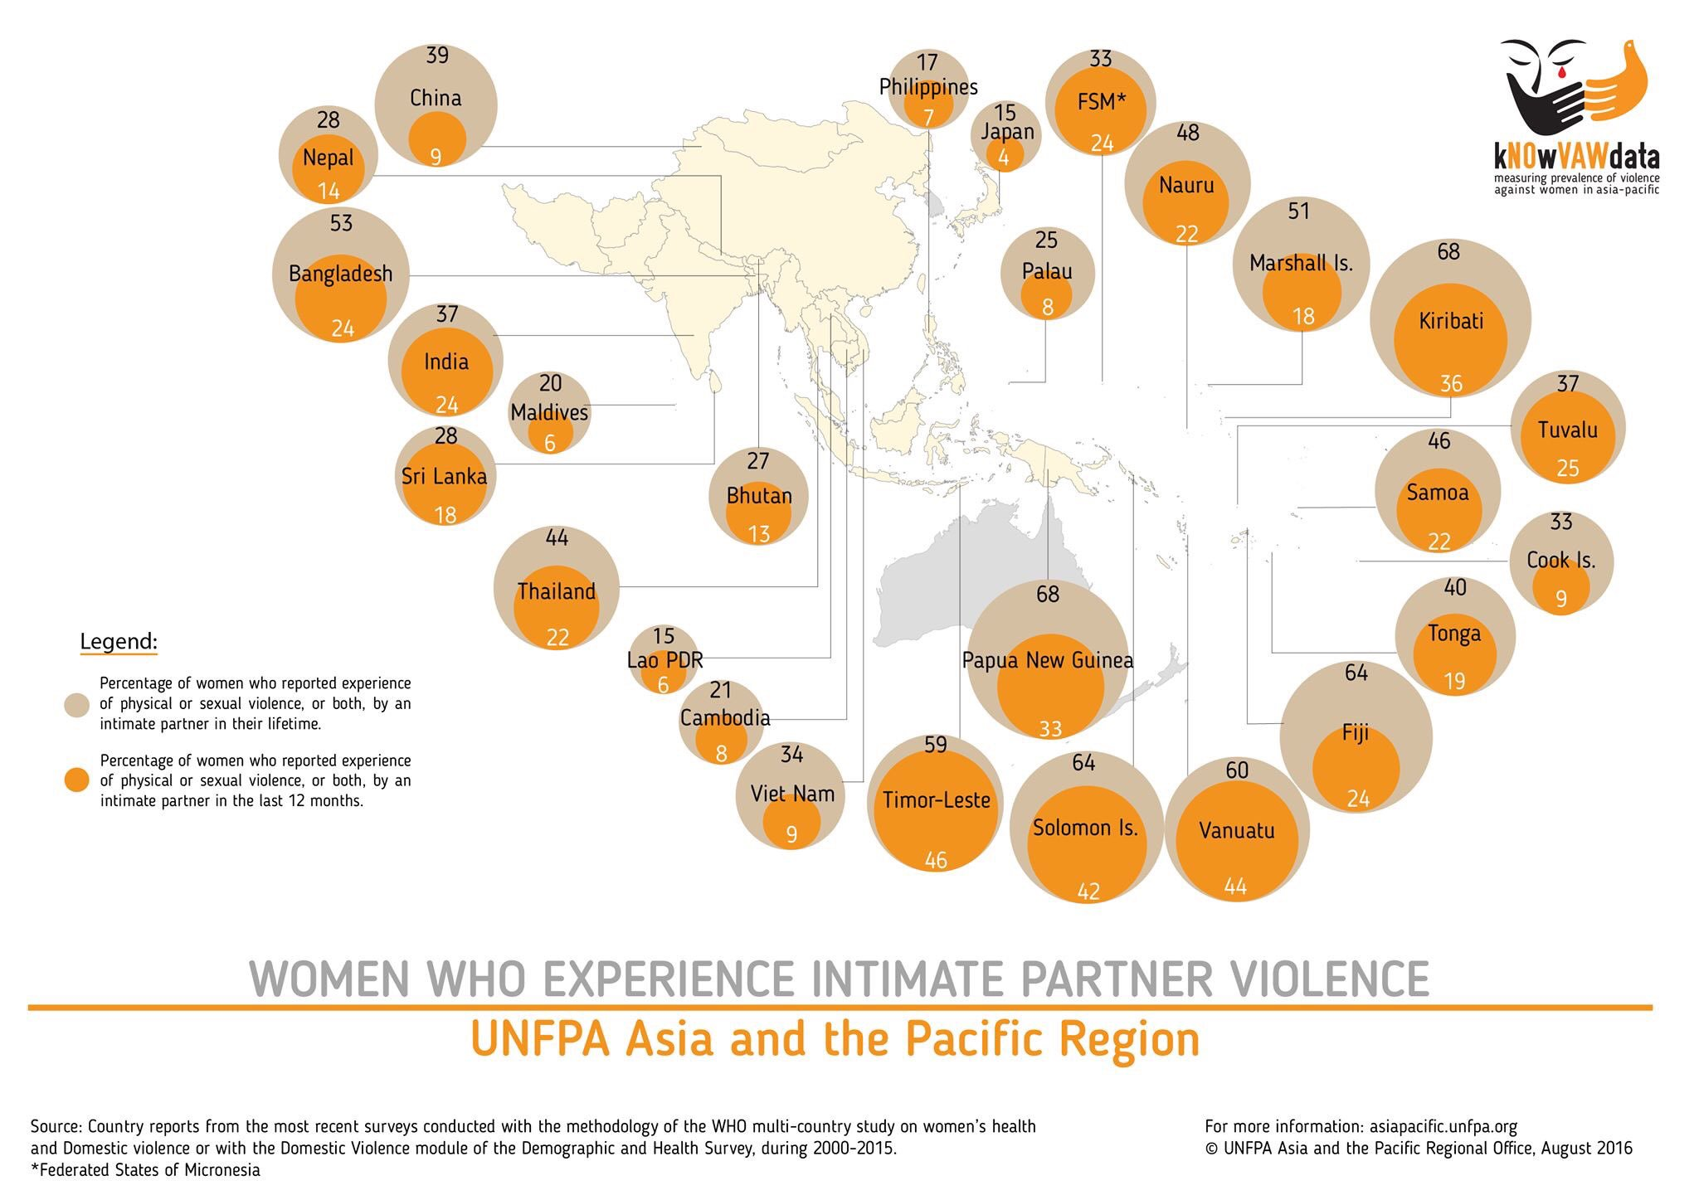
Notes:
National surveys have been conducted in Timor-Leste using WHO methodology.
2010 Demographic Health Survey (DHS)
2016 Nabilan Survey
2017 DHS
Refer to the slide to show how Timor compares. It is quite a high figure compared with Vietnam or Cambodia, but of course, it is also dependent on how comfortable women feel to disclose what is happening to them.

Slide 9
Percent of women who have experienced violence by district
Percentage of ever-married women age 15-49 who have ever experienced emotional, physical, or sexual violence committed by their current or most recent husband/partner
Source: 2016 DHS
Notes:
Women’s reports of intimate partner violence varies greatly by district from a high of 65% in Oecussi to a low of 25% in Baucau.
This may also be reporting differences. What do you think?

Slide 10
Types of intimate partner violence and prevalence in Timor-Leste
Notes:
This slide illustrates what women in Timor have reported to researchers in a recent survey called Nabilan. The left line refers to what percentage of women have experienced it and the bottom line the types of violence they report.
In Timor, just under half of all women aged from 15-49 years old report ever having experienced the many forms of violence, physical, sexual, economic and emotional. Many women have experienced a combination of forms of violence either in the last twelve months (the yellow columns) or ever in their lives (the purple column).

Slide 11
What is sexual assault?
Forcing someone to have sex or participate in sexual acts when they don’t want to
Can include pressuring someone to:
  have sex by threatening them
  touch someone’s genitals
  get someone to touch to their genitals
  show parts of their body
  do sexual acts with other people watching
  watch pornography
Source: 2010 DHS
Notes:
Ask students ‘what acts do you think are included as sexual assault?’
Forcing someone to have sex or participate in sexual acts when they don’t want to
Sexual assault can include:
Putting pressure on someone to have sex by threatening or frightening them
Touching someone’s genitals
Getting a person to touch their genitals
Pressuring someone to show parts of their body
Pressuring someone to do sexual acts with other people watching
Pressuring someone to watch pornography

Slide 12
Sexual assault
Source: 2016 DHS
Notes:
Ask students to look at the graph. Ask them what they think this information says?
Sexual assault is a crime most often committed by a current or former husband, much more often than by a stranger
Many people think that sexual assault against women is committed by strangers. This is a myth.

Slide 13
What is child abuse?
Physical, emotional, psychological or sexual mistreatment of children
Neglect and abandonment
Sexual abuse often occurs with manipulation by the adult
Commonly by a member of the child’s family (incest)
Notes:
Child abuse is the physical, emotional, psychological or sexual mistreatment of children
Neglect and abandonment are types of child abuse
Physical abuse includes hitting, kicking, punching, scaring, burning, and pulling forcefully
Child sexual abuse is often carried out without physical force, but rather with manipulation (e.g. psychological, emotional or material).
Sexual abuse is often committed by a member of the child’s family (incest)
Adolescents may also experience sexual abuse at the hands of their peers, including in the context of dating or intimate relationships
Different types of abuse can occur at the same time
Witnessing violence in the home or in the community can have a negative impact on children, even if they are not beaten themselves. Witnessing violence can be very frightening for children, they may have constant worries about their safety and it can affect their ability to concentrate at school. Children can mimic these violent behaviours toward their siblings or peers, and grow up to repeat these patterns in their own relationships as adults.

Slide 14
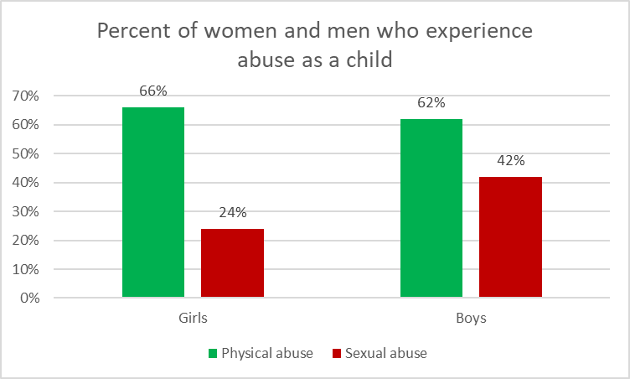
Child abuse in Timor-Leste
Source: 2016 Nabilan Survey
Notes:
This is data from the Nabilan survey, conducted in 2016 with women from all districts in Timor-Leste, and with men in Dili and in Manufahi, about their experiences of abuse as a child
It shows that both boys and girls experience very high rates of physical and sexual violence. Child abuse is a big issue in Timor-Leste.
Also note, the rates of sexual abuse in this survey are higher for boys than they are for girls.
It is a myth that sexual abuse only happens to girl children.

Slide 15
Activity: Identifying child abuse
Break into groups
Read the scenarios on the handout and decide whether each one is child abuse, child neglect or acceptable discipline
What are the possible effects on the child?
What should be done in each case?
Present back one of your answers to the class
Notes:
Purpose: to discuss the difference between child abuse, discipline or child neglect
Time: 15 minutes (10 minutes discussion in groups, 5 minutes to feedback answers)
Instructions:
Break into groups
Ask students to read the scenarios on the handout and decide whether each one is child abuse, child neglect or acceptable discipline
Ask them to discuss the possible effects on the child
Ask what they should have done in each situation
Each group should present back their answers for one or two scenarios
There are points on the facilitator’s handout to help you discuss the answers

Slide 16
Frequency of violence from a husband/boyfriend
Majority of women who have experienced violence said it occurred 3 or more times
Most violence is severe and frequent
Notes:
In Timor-Leste 81% of women who experience violence say it happens frequently
Violence is usually recurring, and is a progressive pattern of escalading abusive behaviour
It is a myth that the majority of women only experience violence once

Slide 17
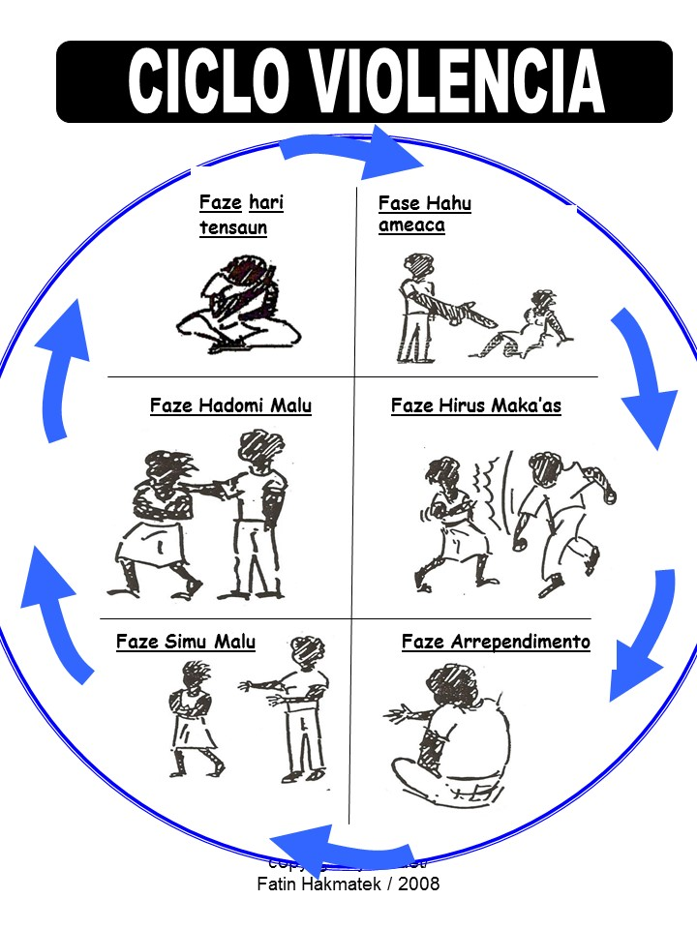
CYCLE OF VIOLENCE
Notes:
For many people, violence and abuse occur in cycles.
Children who grow up witnessing violence in their home are more likely to perpetrate violence or to be victims of violence as adults
There also tends to be a pattern or cycle of violence within relationship where tension slowly builds and the threats increase until the man uses violence again.
After this, he can commonly feel guilt and promise that it will not occur again – until the next time happens.
Often the severity of violence increases over time
If the man abuses alcohol, often the injuries are more severe
The woman’s or the children’s life can be at risk.
It can be useful to talk about this cycle of violence with a women, to help her to see the patterns are increasing and to help her understand the risks to her and her children’s safety and give her information to help.

Slide 18
Activity: Vulnerable groups
Break into pairs
List who is most vulnerable to violence in our communities?
Share one group that you believe is more vulnerable and why
Notes:
Purpose: to understand who is most vulnerable to being subjected to violence in our community
Time: 15 minutes (10 minutes discussion, 5 minutes feedback)
Instructions:
Ask the group to break off into pairs
They need to list on their paper what groups they believe are most vulnerable to violence in our communities and sucos and why
When everyone has had a chance to write their list, go around the group and ask each pair to name one group that they believe is more vulnerable and their reasons why this group is more at risk of violence
Record each vulnerable group up on a central piece of butcher paper – no pair is able to give information on a group that has already been recorded on the central butcher paper
Below are some examples of vulnerable groups, however the students may have others to add to this list:
Young women, children
Women with a disability
Girls who marry at a young age
Women who are abandoned or separated
Pregnant woman or with an unwanted pregnancy
Adopted children/step children
Children living away from their home (ie. In Dili for education)
Gay, lesbian and transgender people (the stigma and violence they are subjected to in their families and communities, as well as possible violence within same-sex relationships)

Slide 19
Who is most vulnerable to domestic and sexual violence in Timor-Leste?
Women
Children
People with a disability
Formerly married women (abandoned, separated, widowed)
Pregnant women
Gay, lesbian and transgender people
Women with HIV/Aids
Source of statistics: 2016 Nabilan survey & 2010 DHS
Notes:
Women - Around 50% of women have experienced physical and/or sexual violence from their intimate partner
Children - More than 70% of boys and girls have experienced physical and/or sexual abuse as a child
Women with a disability are twice as likely to experience violence
Formerly married women (abandoned, separated, widowed) are much more likely to experience physical violence often
Pregnant women - 14% of women have experienced violence during pregnancy
Gay, lesbian and transgender people – 87% have experienced harassment and violence at some point in their lives (from a 2017 report by Rede Feto)
Ask the students ‘can anyone explain why these people are more vulnerable to violence?’

Slide 20
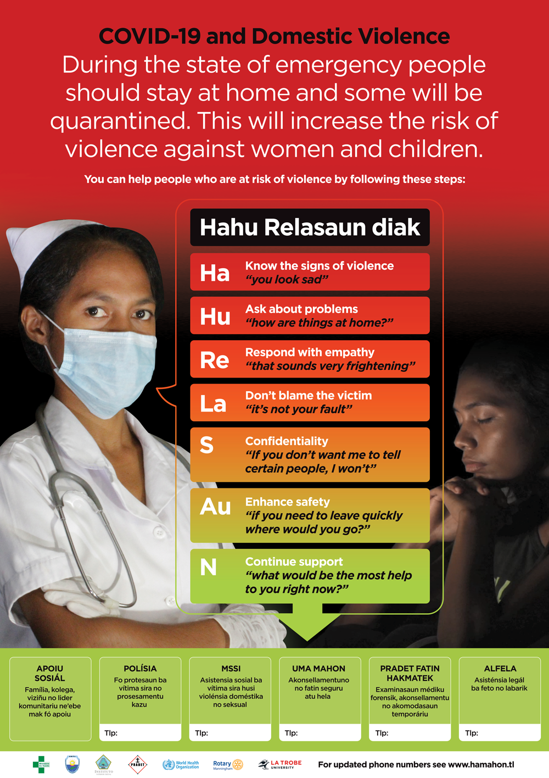
Domestic violence during crises
Domestic and sexual violence increase after emergencies
This is because:
  Families at home together
  Reduced access to support
  Increased alcohol use
  Increased stress
Vulnerable people become more isolated
Notes:
Domestic violence, sexual assault and child abuse are likely to increase after emergencies like natural disasters, health epidemics such as COVID-19 and political conflict
This is because:
Families are together at home for longer periods (i.e. during the state of emergency)
Reduced ability to move around, or access services and community support such as school. This means it is more difficult for women and children to escape from violent situations.
Increased alcohol consumption by men who use violence, can make the violence worse.
Increased stress such as no job, not enough food or money. But it is important to remember that these are not reasons to justify domestic violence.
As health providers we need to be aware of the increased risks of domestic and sexual violence during emergencies, especially for vulnerable people who will be even more isolated than before.

Slide 21
Important messages
Violence takes many forms
Some people are more at risk of violence
Violence gets more severe over time and during crises
Need to stop the cycle of abuse
Complete reading – Nabilan Summary Report (pg 19-38).
Notes:
There are many forms of violence against women and children, including emotional, economic, physical and sexual violence.
Some people such as women with a disability, those separated or abandoned, or children living away from home are more vulnerable to being abused. Health providers should be aware of the additional risks and be ready to help.
Violence increases during emergencies, and if someone is being abused, the violence is likely to escalate over time, unless something is done to stop the cycle of abuse.
Please complete the reading for module 1 at home – the Nabilan summary report (pg 19-38) found in your list of readings.

