Slide 1
Self-care
The broader health system
Review of course
Module 15

Slide 2
Module 15: Learning Objectives
How to look after their physical and emotional health, and safety of themselves and colleagues
Factors in the health system that contribute to good practice and safety for clients and staff
Notes:
At the end of this session students should be able to demonstrate knowledge of:
How to look after their physical and emotional health, and safety of themselves and colleagues
Factors in the health system that contribute to good practice and safety for clients and staff
Ask the students what do they think self-care means and why it is important?

Slide 3
Why self-care is important
Asking leads to more disclosures
Vicarious trauma
Negative feelings
May trigger memories or emotions
Need to be well to be able to help
Being a good example
Notes:
Asking about violence will lead to more disclosures
Vicarious trauma can happen when people hear about or help people with traumatic experiences. Midwives in the Parteira Kontra Violensia research said this was especially difficult in cases of child abuse. Vicarious trauma can have a negative impact on the safety, health and wellbeing of health providers
It can lead to negative feelings such as vulnerability, loss of control, helplessness, negative view of the world
May trigger memories or emotions if the helper has also experienced abuse
You need to be well to be able to help someone. You cannot help someone if you don’t look after your own needs.
Self-care provides a good example for colleagues and patients and may encourage them to look after themselves as well

Slide 4
Looking after ourselves
Work, rest, play balance
Regular exercise and sleep
Eat well
Spend time with friends
Distraction, escape
Meditation/relaxation/breathing exercises
Prayer
Talk with trusted colleagues and managers
Notes:
Work, rest, play balance
Regular exercise and sleep
Eat well
Spend time with friends
Distraction, escape
Meditation/relaxation/breathing exercises
Prayer
Talk with trusted colleagues and managers

Slide 5
Activity: Relaxation techniques
Slow breathing technique
Progressive muscle relaxation technique
Notes:
Purpose: To demonstrate relaxation techniques
Time: 5 minutes each exercise
Slow breathing technique
Sit with your feet flat on the floor. Put your hands in your lap. After you learn how to do the exercises, do them with your eyes closed. These exercises will help you to feel calm and relaxed. You can do them whenever you are stressed or anxious or cannot sleep.
First, relax your body. Shake your arms and legs and let them go loose. Roll your shoulders back and move your head from side to side.
Put your hands on your belly. Think about your breath.
Slowly breathe out all the air through your mouth, and feel your belly flatten. Now breathe in slowly and deeply through your nose, and feel your belly fill up like a balloon.
Breathe deeply and slowly. You can count 1-2-3 on each breathe in and 1-2-3 on each breath out.
Keep breathing like this for about two minutes. As you breathe, feel the tension leave your body.
Progressive muscle relaxation technique
In this exercise you tighten and then relax your body. Begin with your toes.
Curl your toes and hold the muscles tightly. This may hurt a little. Breathe deeply and count to 3 while holding your toe muscles tight. Then, relax your toes and let out your breath. Breathe normally and feel the relaxation in your toes.
Do the same for each of these parts of your body in turn. Each time, breathe deeply in as you tighten the muscles, count to 3, and then relax and breathe out slowly.
Hold your leg and thigh muscles tight…
Hold your belly tight…
Make fists with your hands…
Bend your arms at the elbows and hold your arms tight…
Squeeze your shoulder blades together…
Shrug your shoulders as high as you can…
Tighten all the muscles in your face…
Now, drop your chin slowly toward your chest. As you breathe in, slowly and carefully move your head in a circle to the right, and then breathe out as you bring your head around to the left and back toward your chest. Do this 3 times. Now, go the other way…inhale to the left and back, exhale to the right and down. Do this 3 times.
Now bring your head up to the centre. Notice how calm you feel.

Slide 6
Staff safety
Your human right not to be assaulted
Risk management procedures in place
Have support mechanisms and resources available
Support colleagues
Routine debriefing for challenging cases
Notes:
It is your human right not to be assaulted
Health management should develop a risk management plan for their clinic or area of responsibility which details procedures to protect staff safety
Health managers need to be aware of the stress on their staff and colleagues and make sure support mechanisms and resources are available
Healthcare professionals should care for each other and build a workplace culture that supports providers to respond to victims of violence
Routine debriefing about challenging cases with trusted colleagues can be a good way to promote safety and support each other. It can also influence quality improvement for responses in the future.

Slide 7
Activity: Patient and staff safety
Read the case study and discuss the following questions
What steps do you need to take to ensure both the safety of your patient and of you and other staff?
What tasks need to be done by yourself or the other staff?
Is there anything you could do differently next time a patient who has suffered injuries from violence presents at your clinic?
What could be done to support you and the other staff members?
Notes:
Purpose: To examine the safety needs of patients and staff in a clinical setting
Time: 15 minutes (10 minutes discussion, 5 minutes feedback to the group)
Instructions:
1. Read the case study and discuss the following questions
What steps do you need to take to ensure both the safety of your patient and of you and other staff?
What tasks need to be done by yourself or the other staff?
Is there anything you could do differently next time a patient who has suffered injuries from violence, presents at your clinic?
What could be done to support you and the other staff members?
2. Get each group to feed back their response to one of the questions
3. Suggested answers are in the handout of the facilitator’s manual
Case study
You are working in a community health centre and a woman is brought in by the police for examination and treatment. The police were unable to take her directly to the hospital as they did not have enough fuel in their truck. The patient is 26 years old and has been sexually and physically assaulted and she is semi-conscious. You quickly assess that she needs to be triaged and transferred to the local hospital to best manage her head injury. You do what you need to do to stabilise her, document carefully and make arrangements for the transfer (by ambulance, taxi or truck depending on what is available). Once this arrangement has been confirmed the police leave and you stay with your patient to continue to monitor her and reassure her as she drifts in and out of consciousness, as you wait for transport. All of a sudden a man enters the clinic, he is drunk and angry and is the husband of your patient. He demands that his wife must leave with him now. There are two other female staff present and you have noted that the man has a knife. Your immediate thoughts are for the safety of your patient and staff.

Slide 8
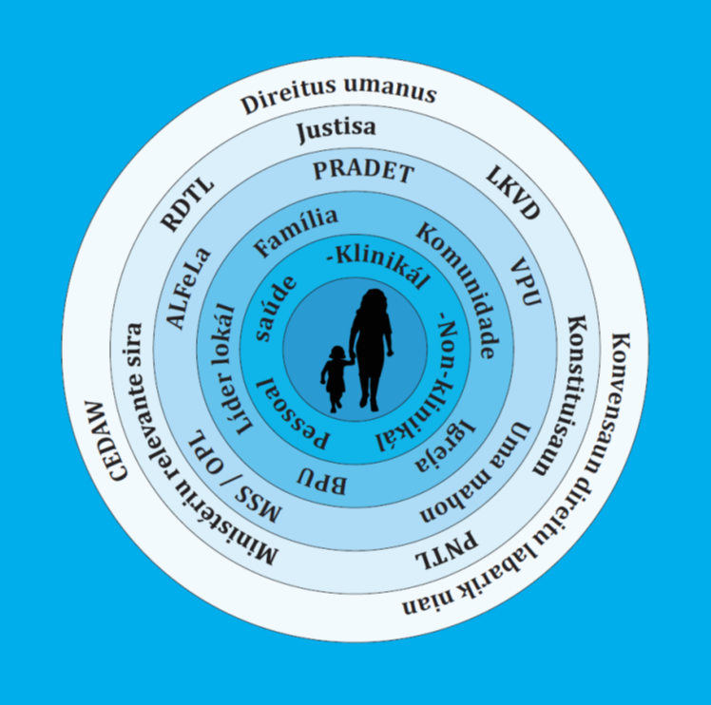
Who is responsible for your safety?
Notes:
Ask the students who they think is responsible for their safety when they begin working as a nurse/midwife?
Some suggestions of roles to discuss:
Ministry of Health
District health administrator
Hospital director/ Health Centre director
Police
Village chief / hamlet chief

Slide 9
Discussion: Personal safety
Q. If you are posted in a rural area, or you are working alone, what things can you do to keep yourself safe?
Notes:
Purpose: To think about strategies that can enhance the safety of health providers, particularly for providers working alone or in rural areas
Time: 5 minutes
Instructions:
Ask the students ‘if you are posted in a rural area, or you are working alone, what things can you do to keep yourself safe?
Some suggestions to add to their list:
Know the community police
Think about who has power in the village and who you can ask for help
Always have a charged phone with credit
Put people’s numbers in your phone to call them quickly if you need to
Agree an emergency signal with your colleagues and neighbors
Don’t work anywhere that is not safe for you
Health staff shouldn’t live alone
Have a door that can be locked
Know how you can escape from a room (an exit door or window)
Get a dog

Slide 10
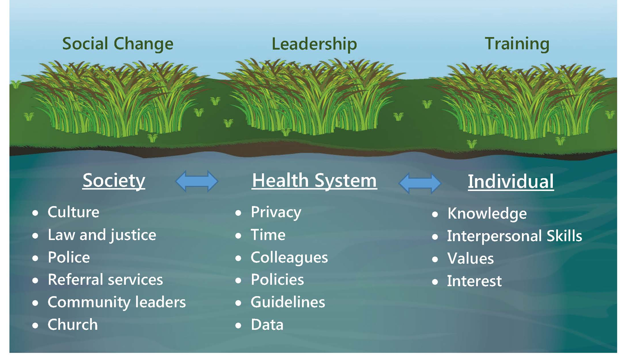
Working together to stop violence against women and children
Lately what’s happening around the clinic is I’m volunteering to do this work. I bring in other services and talk about responding to violence. They see other people doing good things and it’s changing the social atmosphere in this clinic – 7. Domestic Violence Social Worker, Dili
Source: 2016 Parteira Kontra Violensia report
Notes:
Remember you are not working alone
With good training, health system support and the changes happening around violence in our community – we can work together to stop violence against women and children

Slide 11
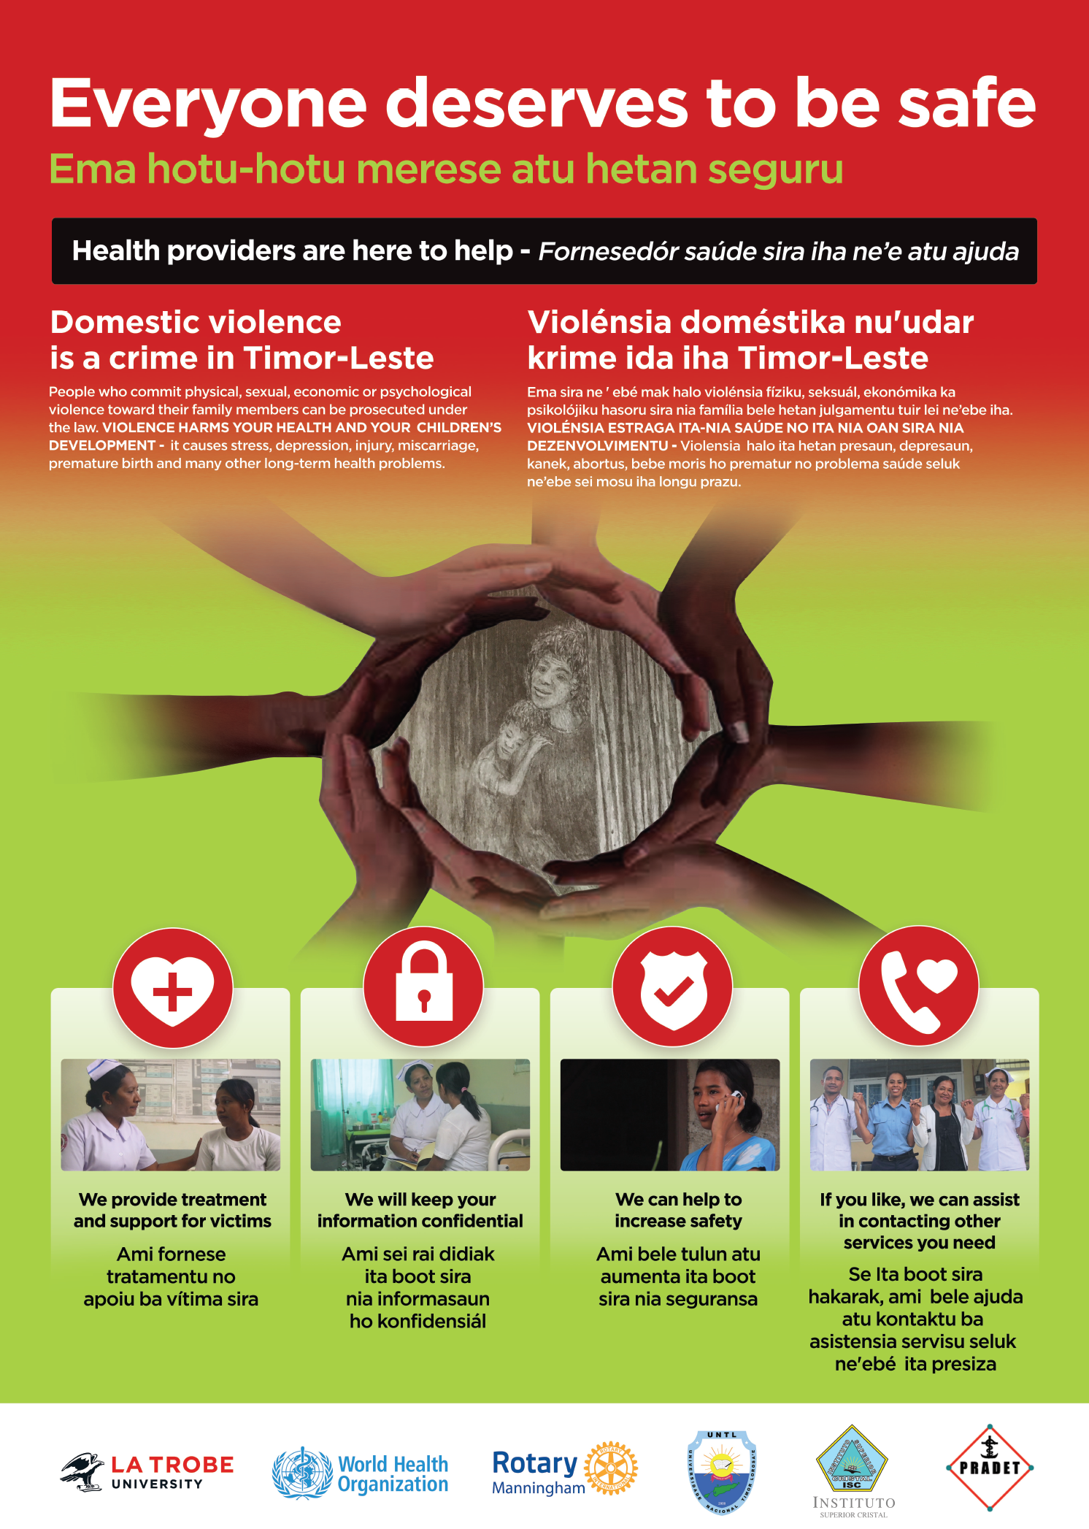
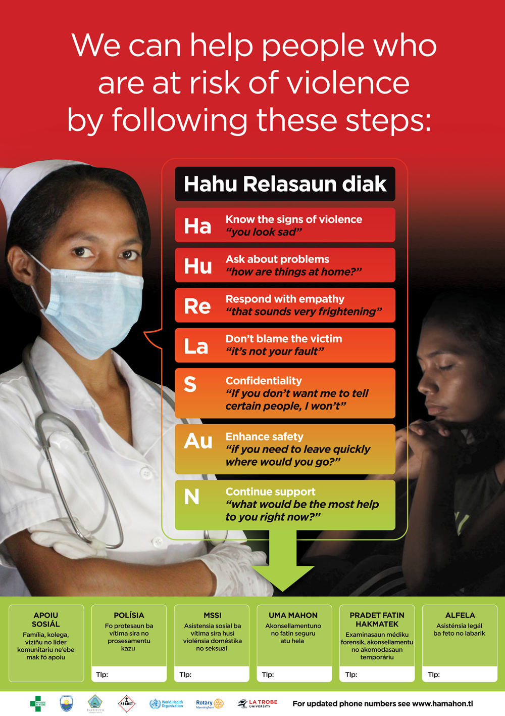
Resources
Posters that can be put up in health centres
a. For toilets or waiting rooms
b. For consultation rooms
Notes:
There are two posters in the handouts that can be put in health centres:
One for the toilets or waiting room. It shows clients how health providers can help
The second shows the steps in Hahu Relasaun diak and can be put up in the consultation room to help you remember how to respond
For printable versions of these posters go to www.latrobe.edu.au/reducing-violence

Slide 12
Activity: Looking after colleagues
Form pairs
Read the case study in the handouts
Discuss what Domingas should do
Make some notes to feedback to the larger group
Notes:
Purpose: To understand how to support colleagues and friends who are subjected to violence
Time: 15 minutes (10 minutes discussion in pairs, 5 minutes feedback to group)
Instructions:
Form pairs
Read the case study in the handouts and
Discuss what Domingas should do.
Make some notes to feedback to the larger group.
Ask one group to feedback first, then ask the other groups if they have any steps that have been missed
Some suggestions to discuss:
Invite Dra. Ana to have a cup of tea or go for a walk
Tell her you are concerned about her
Ask her only when she is on her own
Use the steps in Hahu Relasaun with colleagues as you would with patients
Respond with empathy, don’t blame her
Reassure her about confidentiality, that you won’t tell anybody else about her problems
Let her know about services and support available

Slide 13
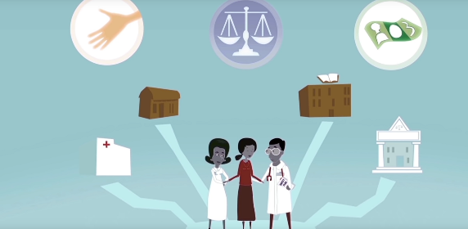
Video: Violence against women: Strengthening the health system response
https://www.youtube.com/watch?v=Qc_GHITvTmI
Notes:
This video is from the World Health Organisation and shows how important it is to have a good health system response for survivors of violence
The video can be played directly from the internet via this Weblink: https://www.youtube.com/watch?v=Qc_GHITvTmI

Slide 14
Important messages
This is difficult work, we need to look after ourselves
Health staff need to look after each other and keep themselves and their clients safe
Together we can build a strong health system and prevent violence in our communities
Notes:
Helping victims of violence is difficult work, so we need to take time to look after ourselves.
You, your colleagues, managers and the community all play an important role in looking after each other and keeping yourself and your clients safe.
Together we can build a strong health system and help prevent violence in our communities.

Slide 15
Activity: Review key learning
Q. What are the main things you learned throughout this course?
Notes:
Objective: To review key learnings from the course (could also be done at the end of each session)
Time: 15 minutes (5 minutes to write down key learnings, 5 minutes to feedback, 5 minutes for questions)
Instructions:
Ask the students to write about the main things they learned throughout the course
Each student should share one key learning with the class, but they are not allowed to repeat what someone else has said so they must come up with a new one
Go through the learning objectives from weeks 1 – 9 and answer any questions the students have

