Slide 1
Documentation
Module 10

Slide 2
Module 10: Learning Objectives
At the end of this session students should be able to demonstrate knowledge of:
How to carefully and confidentially document information about domestic violence, sexual assault and child abuse
When and how to refer for a medical forensic examination
Notes:
At the end of this session students should be able to demonstrate knowledge of:
How to carefully and confidentially document information about domestic violence, sexual assault and child abuse
When and how to refer for a medical forensic examination

Slide 3
Documenting domestic violence, sexual assault and child abuse
Part of a health provider’s role
Always document basic information
  history
  health problems and injuries
  safety assessment
  follow-up plans
Notes:
Documentation is part of a health provider’s role
Health providers should always document basic information as part of routine clinical care. This includes:
History
health problems and injuries
safety assessment
follow-up plans

Slide 4
Why is documentation important?
Reminder to reassess for violence or trauma
Evidence for the prosecution of crimes
Evidence of repeated abuse means harsher penalties
Not documenting properly can jeopardise the woman’s safety, health and justice
Helps in monitoring programs and improving service delivery
Notes:
Why is documentation important?
It reminds you or another provider at a later visit to reassess for domestic violence or sexual assault and ongoing symptoms or health issues with the patient
It provides evidence of injuries and other health conditions that can be used for the prosecution of crimes
Evidence of repeated abuse means perpetrators can be given harsher penalties under the law
• There can be bad outcomes for the woman’s safety, health and justice if you do not properly document the clinical management of violence or if you break the woman’s confidentiality
• Good documentation can help managers and policy-makers to monitor program quality and improve service delivery

Slide 5
Before you document
Ensure safety, privacy and confidentiality
Tell her what you would like to write down and why
Ask for consent
Do not write things she doesn’t want documented
Notes:
Ensure safety, privacy and emotional wellbeing of the client during the consultation
Explain that you will keep her information confidential, which means you will not share it with other patients or anyone in the community, but it will be seen by other health professionals providing her with care and may be used to report the information to the police
Tell her what you would like to write down and why
Ask for her consent to document the history and examination, and follow her wishes
If there is something she does not want documented, do not write it in the medical record

Slide 6
What to document
Details of the assault, using her words
Health problems and injuries
Physical examination and emotional condition
Safety assessment
Follow-up plans
Notes:
Details of the assault, using her words in quotations “my husband, Manuel, beat me up and raped me this morning”
Health problems, symptoms or signs, including injuries if present
Head to toe physical examination: findings including emotional condition and injuries, using drawings
Danger assessment and safety plan
Follow-up plans for physical and mental health, including details of referral to other organisations

Slide 7
Injury documentation
Type of injury
Description
Location on body
Cause
Consequences
Treatment provided
Notes:
Type of injury (cut, bruise, abrasion, fracture, other)
Description (length, depth, other characteristics)
Location on body
Cause (knife, bite marks, stick)
Consequences: physical and psychological, immediate and long-term
Treatment provided
•When sexual assault, rape or physical violence takes place, sometimes there are no visible injuries. It is still important to document the details of the assault, emotional state and psychological impact

Slide 8
Preserving confidentiality
Do not write anything where it can be seen by others
Be cautious about what you write and where
Keep a copy of her documentation safe
Notes:
Ask the students ‘what does confidentiality mean to you?’
Do not write anything where it can be seen by those who do not need to know. Example: antenatal record, bed chart, paper slip for x-ray
Be cautious about what you write where, and where you leave any paper record
Make a copy of her file for reporting to authorities and keep her documentation in a locked filing cabinet

Slide 9
Medical Forensic Protocol
Recent assault should be documented by a medical forensic examiner
Medical Forensic Protocol
  Records information about the assault + physical examination
  Used for domestic violence and sexual assault
  For men, women, boys, girls
Notes:
It is better if recent assault is documented by an accredited medical forensic examiner. PRADET train and INS accredit medical forensic examiners who have been trained in the medical forensic protocol. Medical forensic examiners are available in 9 municipal hospitals in Timor-Leste.
The medical forensic protocol (MFP):
This is a form that records detailed information about the assault and head to toe physical examination.
The MFP covers victims of domestic violence, sexual assault and child abuse, men and women, boys and girls
There is an example of the form in your handouts. This can be given to police and used as evidence for the prosecution of crimes.
While accredited Medical Forensic Examiners should fill out the Medical Forensic Protocol form, There may be situations where a victim refuses a referral, they need immediate medical treatment or it is unsafe for her to leave, in which case health providers could undertake more detailed documentation.
If you are unsure or want further information consult with the closest Fatin Hakmatek or victims can speak directly with them

Slide 10
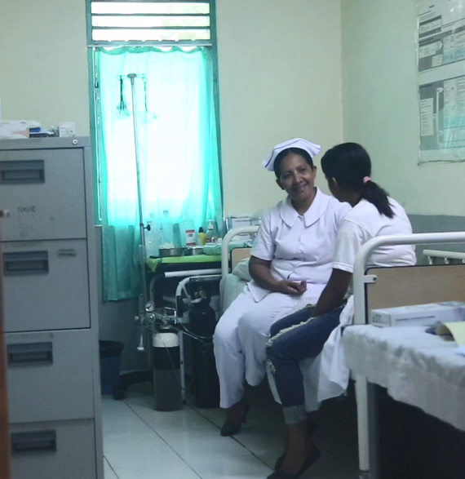
Watch video role play
Watch the video and think about the questions:
a. What information about Maria did the nurse document?
b. Why did the nurse refer Maria to a medical forensic examiner?
c. How did the nurse deal with confidentiality of the written records?
Notes:
Watch the video and think about these questions:
What information about Maria did the nurse document?
Why did the nurse refer Maria to a medical forensic examiner?
How did the nurse deal with confidentiality of the written records?
The video can be played directly from the weblink https://youtu.be/D5Pgnsw-xXs.
Play the section from time 11:55-17:43.

Slide 11
Activity: Video role play
Discussion questions:
  What information about Maria did the nurse document?
  Why did the nurse refer Maria to a medical forensic examiner?
  How did the nurse deal with confidentiality of the written records?
Notes:
Purpose: To observe how a health provider documents a patient’s history and injury and makes a referral
Time: 15 minutes (5 minutes video, 10 minutes discussion)
Instructions:
Discuss the following questions:
What information about Maria did the nurse document?
Her injuries, the story of how they were inflicted, past abuse, safety of children, contact information, sexual assault, contraception, STI symptoms, referral
Why did the nurse refer Maria to a medical forensic examiner?
Full top to toe medical exam, exam of child, for use as evidence for the police or courts
How did the nurse deal with confidentiality of the written records?
Asked permission to record, told Maria that doctor and manager would also be able to access them but not others, kept them in a locked filing cabinet

Slide 12
Activity: Documenting domestic and sexual violence
Break into groups of 2, one is the health provider and one is the patient
Patient reads the scenario and explains symptoms to health provider
Health provider asks questions and documents their story and injuries in the relevant spaces
Swap roles and give each other feedback
Notes:
Purpose: To practice taking a client’s history and documenting their injuries.
Time: 55 minutes (5 minutes to read the case study, 20 minutes for each person to act as the health provider, 10 minutes for feedback)
Instructions:
1. Ask the students to break into groups of 2 (this can also be done with two ‘actors’ presenting to the group)
2. The students should take turns being the health provider and patient
3. Each group gets 2 scenarios you have photocopied (1 each) and they should read the entire scenario to themselves
4. The patient’s role is to describe why they are there or what symptoms they are seeking care for and respond to the questions asked by the health worker
5. The health provider’s job is to ask questions and document their story and injuries, using the sample form provided in the handouts. Not all sections will be relevant for each case. Fill it in as best you can.
6. After each person has had a go at being the health provider and the patient they should talk about how they felt and give each other constructive feedback
7. The facilitator should walk around the room and observe the interactions and the forms, manage the time and give feedback to the pairs as well as the larger group

Slide 13
Important messages
Taking a history is important for treatment and care
Need her consent before examination or taking a history
Explain what will happen and answer questions
All documentation must be kept private
Good documentation is important for evidence
Consult with colleagues if you are unsure or feeling overwhelmed
Read MSS referral guidelines for next module – pg.17-19
Notes:
Treatment and care will depend on the history given by the survivor. Hence, taking history is very important.
Informed consent needs to be taken before the medical history, before the examination. Any limits to confidentiality must be explained as part of the consent process.
Explain all parts of the examination and documentation, make sure it is done in a private place and take time to answer questions
Quality documentation of history, treatment and referrals is essentials as survivors may want to use the medical documentation as evidence for her legal case
Health managers, medical forensic examiners or Fatin Hakmatek can be consulted for best practices on medical record documentation
In preparation for next module – please have a look at the referral guidelines by MSS (especially the steps for health providers on pg 17-19 in English and pg. 18-20 in Tetum)

