Slide 1
2022 RESEARCH
SEMINAR SERIES
11 May

Slide 2
Beyond the dental chair:
The role of caregivers in promoting oral health.
Associate Professor Nathan Wilson

Slide 3
My Background: Health and wellbeing of people with intellectual and developmental disability
Main areas of focus
Disability Workforce
Chronic illness and lifelong disability
Participation
Key partnerships with disability services and peak bodies
Past and Current Projects
Sexual health
Role of nurses who work with people with IDD
Autism CRC – driving and public transport access
Mentoring programs at Men’s Sheds for young adults with IDD
Reducing psychotropic medication
Oral Health and IDD

Slide 4
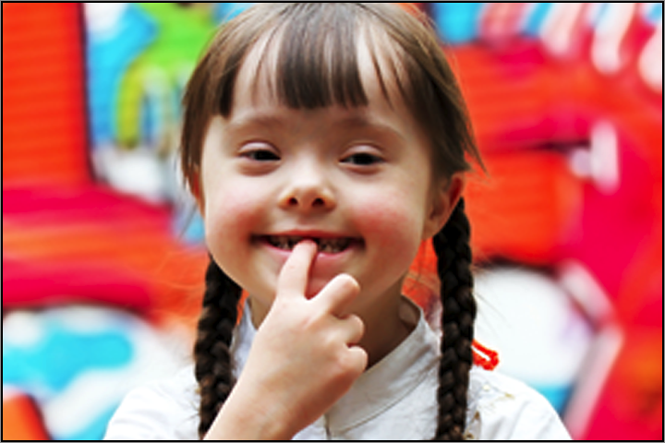
What do we know about oral health and people with intellectual and developmental disability?
Oral health (OH) status very poor
Problems with independence in OH
Lack of OH literacy
Access barriers to OH and other health services
Often multiple chronic and complex co-morbidity
Heavy reliance on caregivers …. Few models of effective caregiver training
Evidence of interventions – very low to low – needs a combination of regular check-ups and targeted individualised effective intervention/s

Slide 5
Oral Health and IDD Literature Reviews
Review 1: problems
Review 2: Solutions
dental procedures was a key issue for females with ID. Poorer oral health, greater numbers of tooth extractions, more caries, fewer fillings, greater gingival inflammation, and greater rates of endentulism
less preventative dentistry and poorer access to services when compared to the general population
Anxiety during oral health care
Wilson et al., (2019a).
Caregivers play a vital role in the provision of oral health support, emphasising the effectiveness of educational interventions for caregivers.
Uncertainty regarding the efficacy of specific tooth brushing interventions for people with IDD.
In cases of more severe IDD and/or dental-related behavioural problems, dental treatment under general anaesthesia was often both a necessary and effective method of oral health care provision.
Outreach and exclusive oral health services as successful strategies for increasing the limited access of people with IDD to oral care services.
Wilson et al., (2019b)

Slide 6
DSWs as Oral Health Champions – genU/DHSV
DHSV and genU developed oral health champions program
Champions agreed to role for one year
Input from experts; Classroom based education session for DSW champions, 3 follow-up sessions.
Champions to lead practice change through peer-led approach
Research/Gvt/service partnership to explore champions’ perspectives of the program

Slide 7
Cont …
Enhanced individual knowledge and led to a number of reported benefits to the people with IDD
Challenges being a champion and effecting change where routines and practices were sometimes entrenched
Initial, and follow-up, workshops promoted awareness that oral health was more than just cleaning teeth and in fact altered the personal practice of some of the champions
No insight into any notable effect on the oral health status of any individuals with IDD – no outcome measures
Wilson et al., (2022a)

Slide 8
Smiles for Life – Westmead Special Needs Dentistry Unit
Smiles for Life education program for paid and unpaid carers – classroom session with short “hands on” component
No evaluation undertaken, but pre-post data were collected
Collaboration between researchers and Westmead team
Matched pairs n=244
Knowledge decreased after the program, more so in carers with fewer educational qualifications
Content was pitched at too high a level – led to confusion
Wilson et al., (2022b)

Slide 9
National DSW Survey - knowledge
Knowledge items | T/F | Correct | Incorrect | N
c. Poor oral health (bad breath, cavities etc.) is NOT linked to certain bacteria in the mouth | F | 108 (71.5%) | 43 (28.5%) | 151
h. It is recommended that all individuals should clean their teeth once per day | F | 56 (36.8%) | 96 (63.2%) | 152
i. Bacteria found in the mouth due to poor oral hygiene can be linked to increased risk of chest infections (Aspiration pneumonia) | T | 93(61.6%) | 58 (38.4%) | 151

Slide 10
National DSW Survey - barriers
Section IV: Barriers | Strongly Disagree | Somewhat disagree | Neutral | Somewhat agree | Strongly Agree | Total cases
a) I don’t have enough skills to provide oral hygiene care for my clients | 36 (25.0%) | 42 (29.2%) | 25 (17.4%) | 30 (20.8%) | 11 (7.6%) | 144
b) There is a lack of guidelines/policies to inform expected oral hygiene care | 26 (18.3%) | 27 (19.0%) | 26 (18.3%) | 49 (34.5%) | 14 (9.9%) | 142
c) There is a lack of adequate oral health training programs | 18 (12.7%) | 11 (7.7%) | 26 (18.3%) | 55 (38.7%) | 32 (22.5%) | 142

Slide 11
National DSW Survey - Training
Section V: Training | Yes | No | Total cases
a) Have you ever received any oral hygiene training | 36 (25.4%) | 106 (74.6%) | 142
c) Did your practice change after training? ****missing: n=121*** | 30 (88.2%) | 4 (11.8) | 34

Slide 12
Potential Solutions?
Australian context – NDIS workforce are a largely unregulated workforce
Our goals:
Scope breadth and depth of the problem
explore workforce knowledge and barriers
Explore and test potential solutions that will “fit” in the NDIS landscape
Next steps:
NHMRC grant application – focussed on children
Grant to develop and test systems-based caregiver intervention

Slide 13
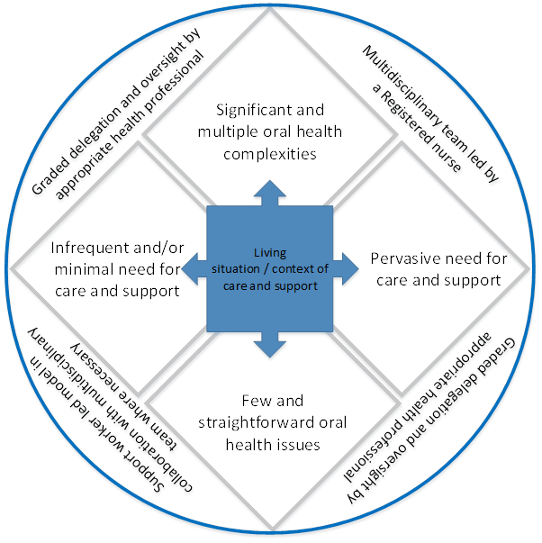
Wilson & Watson (2022)

Slide 14
Summary of needs
Develop interventions to increase the knowledge and improve the practice of carers
Develop interventions to increase the knowledge and improve the practice of people with IDD who can perform OH self-care
Create policy/procedure change at a national level around OH and IDD

Slide 15
References
Waldron C, Nunn J, Mac Giolla Phadraig C, Comiskey C, Guerin S, van Harten MT, Donnelly‐Swift E, Clarke MJ. (2019). Oral hygiene interventions for people with intellectual disabilities. Cochrane Database of Systematic Reviews, Issue 5. Art. No.: CD012628. DOI: 10.1002/14651858.CD012628.pub2.
Wilson, N. J., Lin, Z., Villarosa, A. & George, A. (2019a). The oral health status and reported oral health problems in people with intellectual disability: A literature review. Journal of Intellectual and Developmental Disability, 44(3), 292-304. doi: 10.3109/13668250.2017.1409596
Wilson, N.J., Lin, Z., Villarosa, A., Lewis, P., Philip, P., Sumar, B. & George, A. (2019b). Countering the poor oral health of people with intellectual and developmental disability: A scoping literature review. BMC: Public Health, 19, 1530. https://doi.org/10.1186/s12889-019-7863-1
Wilson, N.J., Lin, Z., Pithouse, M., Vaughan, B., Sumar, B. & George, A. (In press). Qualitative insights from a novel oral health champions programme for staff working within a residential service for people with intellectual and developmental disability. Journal of Intellectual Disabilities.
Wilson, N.J. & Watson, J. (2022). Toward a systems-led, biopsychosocial framework to underpin oral health supports: Commentary on “Evolution of oral status in adults with intellectual and developmental disabilities: A longitudinal study” (Figueira et al., 2021). Research and Practice in intellectual and Developmental Disabilities. DOI: 10.1080/23297018.2022.2051199

Slide 16
Thanks: N.Wilson@westernsydney.edu.au http://www.acioh.com/

