Slide 1
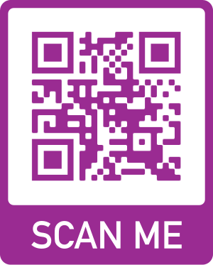
HIV Futures 10
A major national health and wellbeing survey of people living with HIV in Australia. Complete the survey online now or help us promote through your networks.
visit www.hivfutures.org.au or scan the QR code

